Slide 2
Cardless Cash Withdrawal(CCW)
Under the guidance of:
Mr.Sumit Kumar
(Assistant Professor)
Department of Systemics
School Of Computer Science
NAME | Enrollment No.
Ankita Rani | R610218008
Subham Kumar | R610218030
Aman Kumar | R610218005

Slide 3
ABSTRACT
.
Automated Teller Machine (ATM) transactions are found safe, reliable and inevitable these days for fulfilling our financial commitments. Traditional approach for using ATM mandates involvement of Debit card. But however, people do experience times when they forget to carry card and struggle to complete transaction. . Physical cards have some problems too. It can be stolen, skimmed, cloned, hijacked, damaged or expired. To avoid this situation , we are designing an algorithm in C programming Language . Our proposed approach addresses the situation via One-Time Password (OTP) which will be sent on the registered Mail-Id of the user and the user can enter that OTP on the ATM machine and withdraw the required money without the usage of any Debit Card . It is simple and effective approach to withdraw cash without the involvement of debit card which can be referred to as card less cash withdrawal. CCW offers timely service for target beneficiary.

Slide 4
INTRODUCTION
To successfully execute the cardless cash withdrawal the combination of following techniques have been used:
C language- C is a general-purpose, procedural computer programming language. It is machine-independent, structured programming language which is used extensively in various applications.
ATM(Automatic Teller Machine)-An automated teller machine (ATM) is an electronic banking outlet that allows customers to complete basic transactions without the aid of a branch representative or teller.
Socket Programming-Socket programming is a way of connecting two nodes on a network to communicate with each other.
File Handling-File handling in C enables us to create, update, read, and delete the files stored on the local file system through our C program.
Authentication- It is used to create a separate user ID and Password so that only the authorized users will able to access the data.

Slide 5
Encryption- The process of converting information or data into a code, especially to prevent unauthorized access. Decryption- The conversion of encrypted data into its original form is called Decryption. Communication Protocol- In computing, a communication protocol refers to the set of rules that computers use to . communicate with each other.

Slide 6
Literature Review
This project describes the essentials to improve safety in ATM transactions. Due to great increase in the number criminals and their actions, the ATM has become insecure. ATM systems currently use no more than an access card and PIN for identity confirmation. In order to avoid these situations we have implemented cardless transaction which involves no use of any plastic atm cards. Security of the users have been taken into great consideration.We have studied C programming language,File Handling, Encryption- Decryption techniques .

Slide 7
Problem Statement
The existing ATM system authenticates transactions via the card and PIN-based system. But physical cards have some problems. It can be stolen, skimmed, cloned, hijacked, damaged or expired. Due to this problem, we need to think an alternate way to provide better Security. . Users also want an assurance that they can perform a transaction in case of emergency whenever they want and wherever they are even if they do not have their ATM cards with them.
Our project is based on Cardless Cash Withdrawal from ATM with OTP Authentication via Mail using the C
Programming Language.. Thus the application of our system helps the customer in making the ATM system is more
user friendly . Security of the data has been given utmost importance so that users feel secure and safe . This solution
is more convenient and environment-friendly as there is no use of any plastic atm cards.

Slide 8
OBJECTIVE
Our system enables an account holder to withdraw money instantly from their account without using any physical card or filling up any physical withdrawal slip.
Caesar Cipher algorithm have been used for encryption and decryption for secure and safe ATM Transaction.
Password Masking have been implemented to avoid any kind of security issues. The idea behind masking is to prevent nearby observers reading the password "over the user's shoulder“.
File Handling using CSV file has been used to handle the large database of our customers efficiently .
Every transaction of our customers will be updated in our database.

Slide 9
Methodology
1. Project Initiation
Problem Statement identification
Requirements gathering activity – All possible requirements of the Project to be developed are
captured and documented.
2. Implementation of the Algorithm
Study different Algorithms which are
CAESAR CIPHER Algorithm
SMTP Protocol
Analyze the Algorithm
Finalize the Mathematical Approach of Algorithm
3. Project Execution or Implementation
Executing the project to achieve project objectives.
Project is divided into different modules to be executed

Slide 10
4. The various steps included in our system are:
Select Cardless Cash Withdrawal Option on ATM interface.
Authentication of User.
Encryption and decryption of password performed at the backend of user.
Money Withdrawal and Balance Enquiry.
OTP sent on E-mail.
Verification of OTP.
Cash Withdrawal on successful attempt.
5. Integration and Testing
All the modules developed are integrated into a system after testing of each unit.
6. Deployment and Final Submission
Once the functional and non-functional testing is done the project is completed.
Final Report is prepared and submitted.

Slide 11
START
FLOWCHART:CCW
Select CCW option on ATM.
Input UserId and Password
Is UserId and Password Correct?
False
True
Get OTP via EMAIL
Entered OTP is Correct?
False
True
ATM process cash dispense.
END
FIG. 1

Slide 12
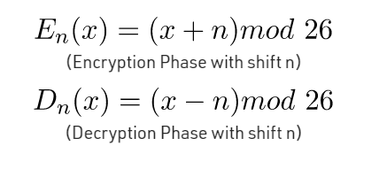
ALGORITHM For Encryption and Decryption
Caesar Cipher Algorithm
Caesar Cipher algorithm is used in this project to encrypt the password of the user for secure file handling and
Decryption can be done whenever required.
The Caesar Cipher technique is one of the earliest and simplest method of encryption technique.
It’s simply a type of substitution cipher.

Slide 13
Steps involved in Caesar Cipher Algorithm. Algorithm for Caesar Cipher: Input: 1. A String of lower case letters, called Text. 2. An Integer between 0-25 denoting the required shift. Procedure: Traverse the given text one character at a time . For each character, transform the given character as per the rule, depending on whether we’re encrypting or decrypting the text. Return the new string generated.

Slide 14
File Handling
In programming, we may require some specific input data to be generated several numbers of times. Sometimes, it is not enough to only display the data on the console. The data to be displayed may be very large, and only a limited amount of data can be displayed on the console, and since the memory is volatile, it is impossible to recover the programmatically generated data again and again. However, if we need to do so, we may store it onto the local file system which is volatile and can be accessed every time. Here, comes the need of file handling in C.
File handling in C enables us to create, update, read, and delete the files stored on the local file system through our C program.
The following operations can be performed on a file.
Creation of the new file
Opening an existing file
Reading from the file
Writing to the file
Deleting the file

Slide 15
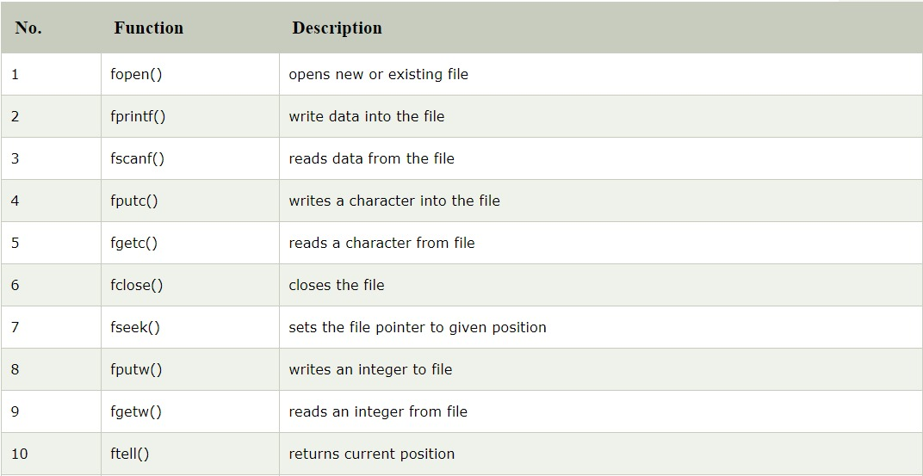
Functions for File Handling
FIG. 2

Slide 16
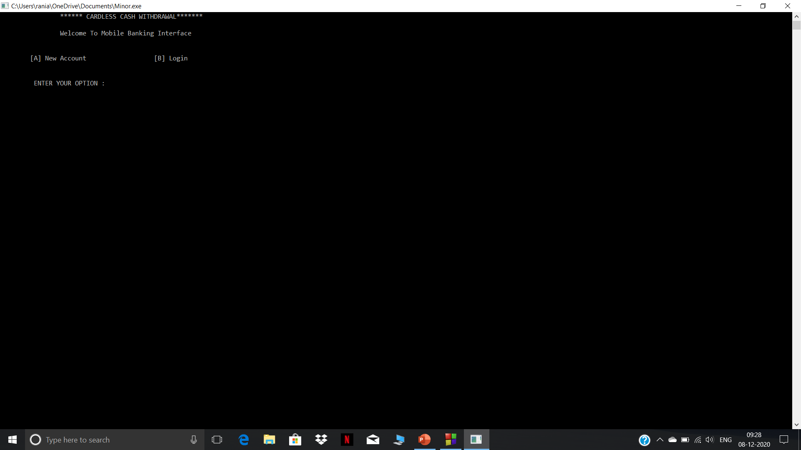
Cardless Withdrawal Interface
FIG. 3

Slide 17
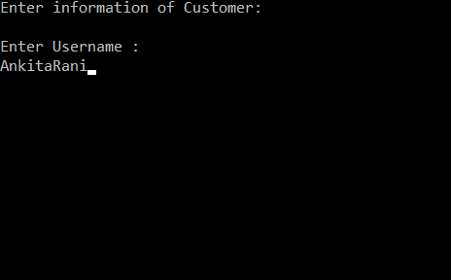

Registration Process
FIG. 4
FIG. 5

Slide 18
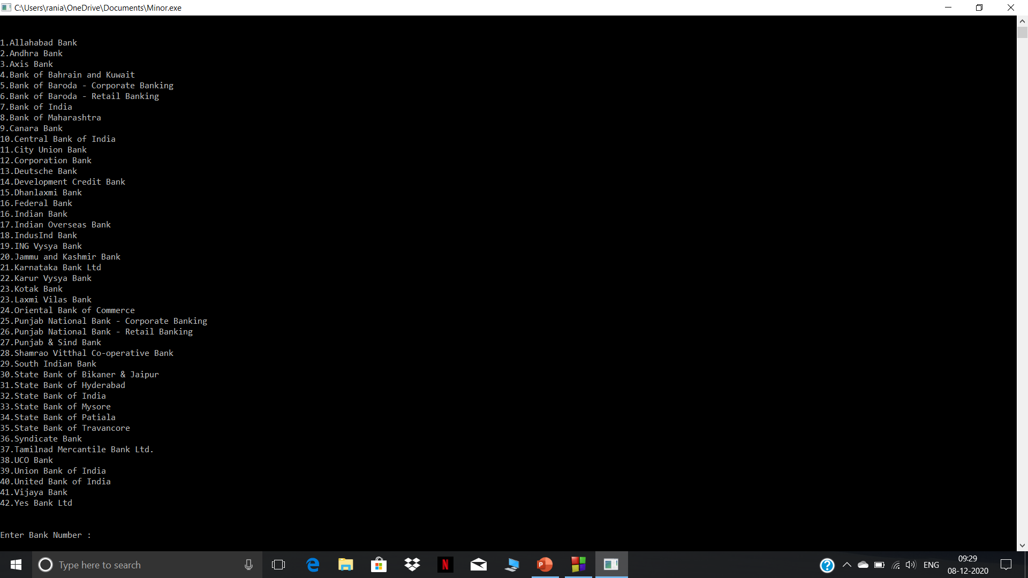

FIG. 6
FIG. 7

Slide 19

SUCCESSFULL REGISTRATION OF NEW ACCOUNT
FIG. 8

Slide 20
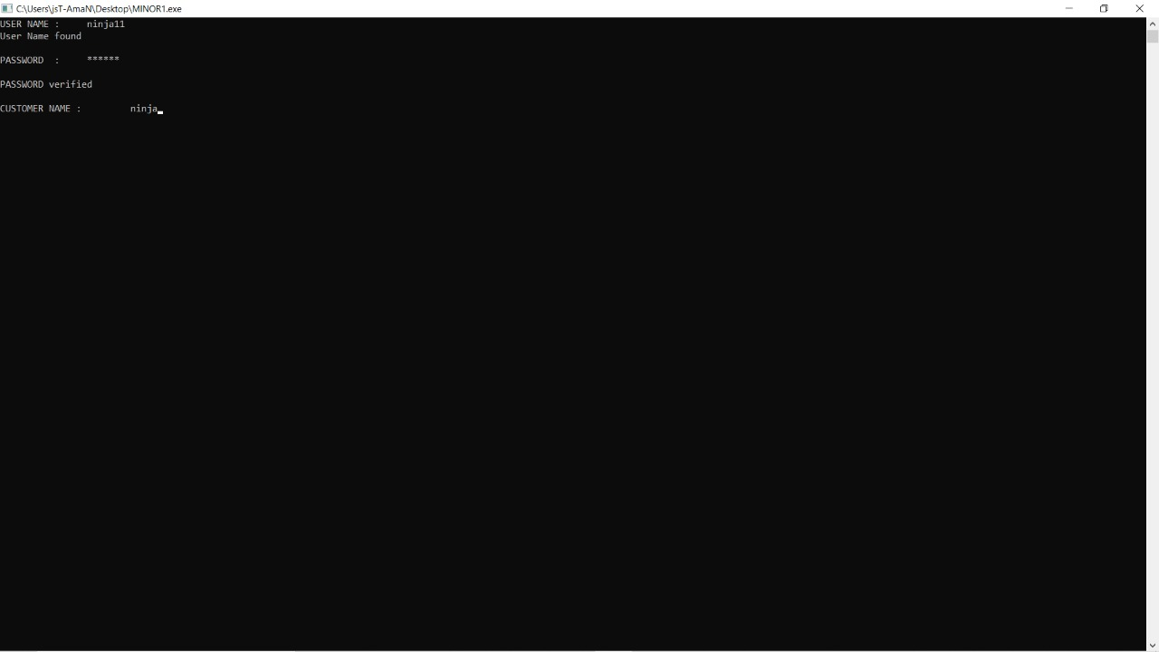

Login Process
FIG. 9
FIG. 10

Slide 21
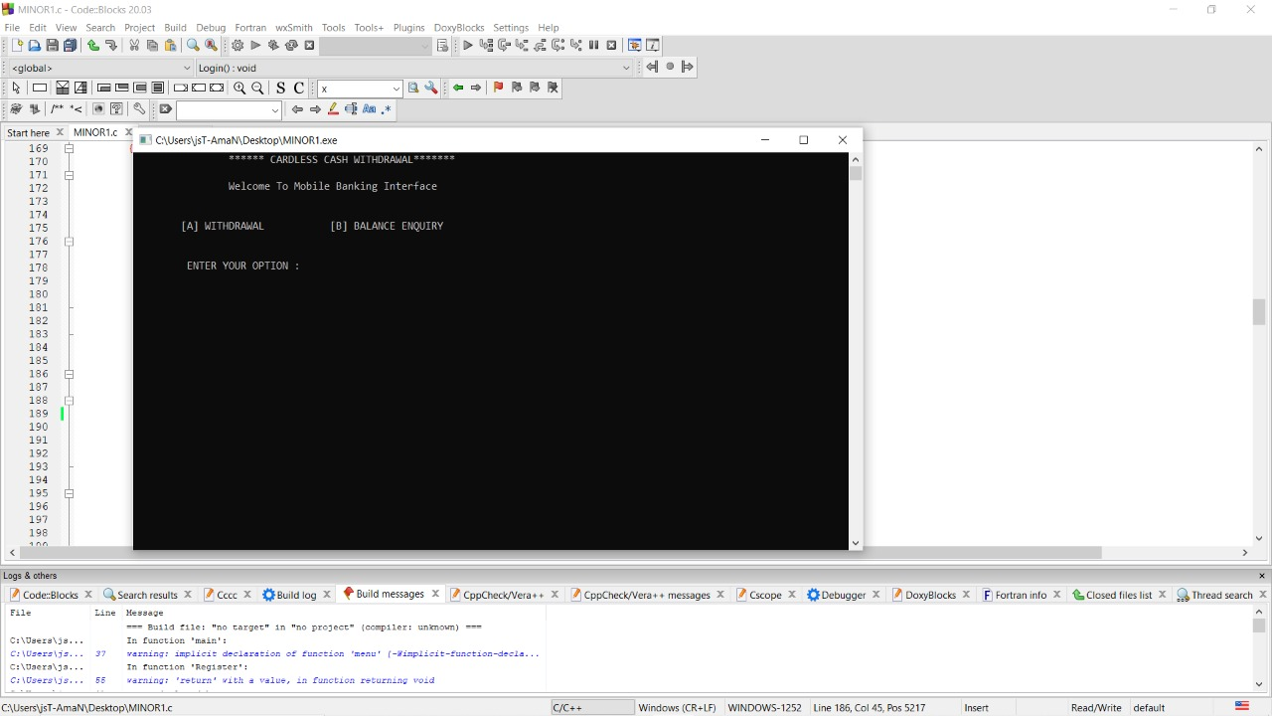
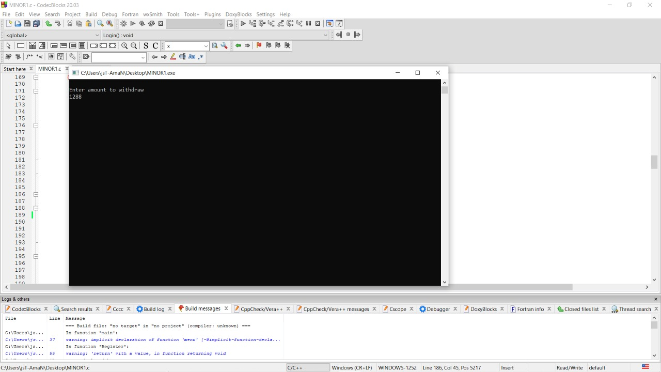
Withdrawal Process
FIG. 11
FIG. 12

Slide 22
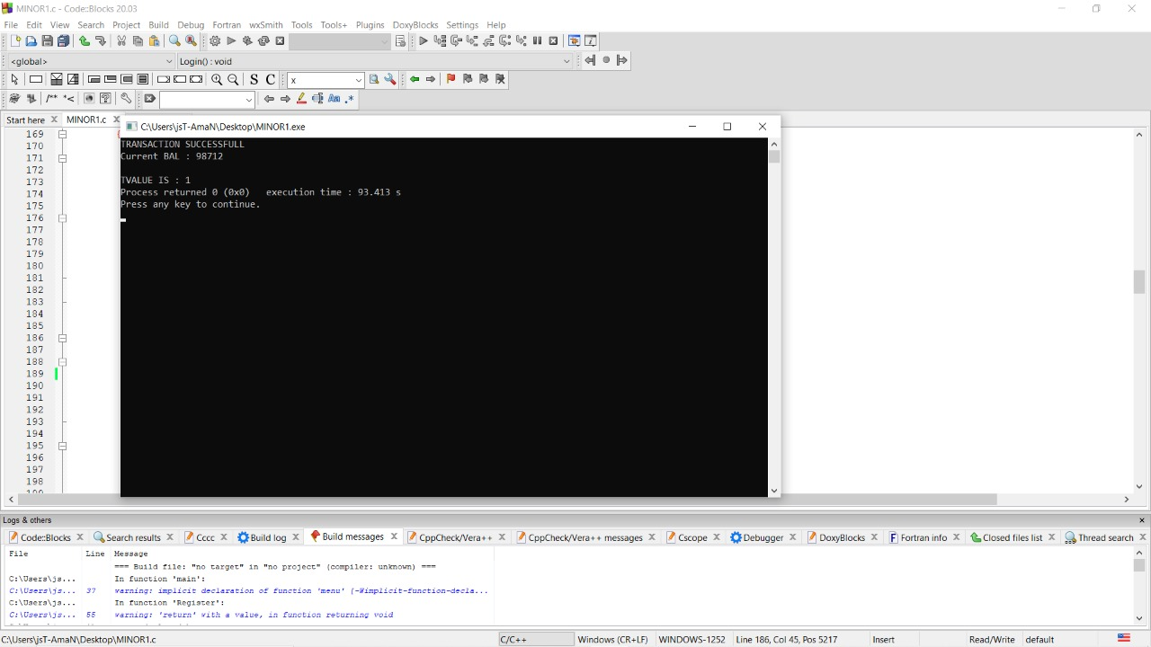
FIG. 13

Slide 23
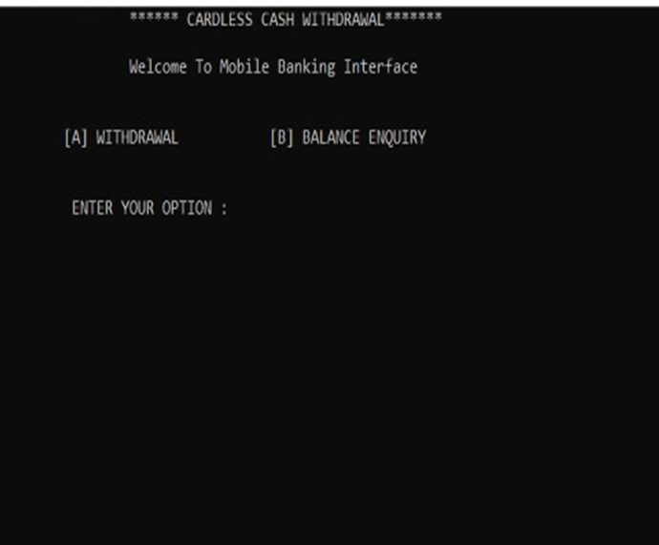
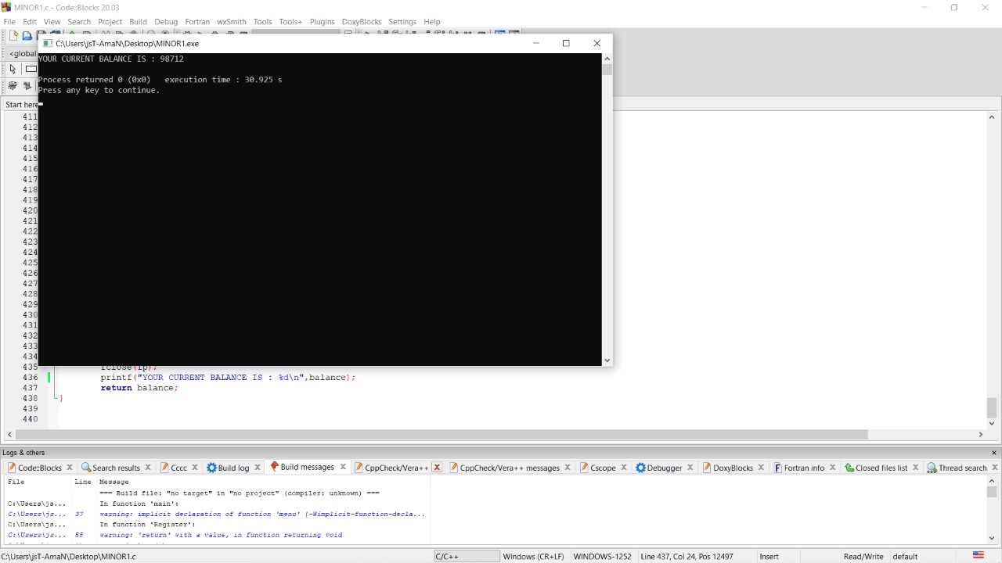
Balance Enquiry
FIG. 14
FIG. 15

Slide 24

Bank Database
FIG. 16

Slide 25
Pert Chart
Planning
Start date-10/08/2020
End Date-16/08/2020
Requirement Analysis
Start Date-17/08/2020
End Date-31/08/2020
Product Design
Start Date-01/09/2020
End Date-14/09/2020
START
Debug
Start Date-20/10/2020
End Date-27/10/2020
Testing
Start Date- 12/10/2020
End Date-19/10/2020
Coding
Start Date-15/09/2020
End Date-01/12/2020
END

Slide 26
CONCLUSION
Till now we have studied about the C programming language and designed a methodology which proposes a
style of cash withdrawal without the involvement of debit card. In the proposed model OTP (One Time Password) will be sent to user on their phone via mail which will be entered by the user on the ATM interface to complete a transaction without the hassle of carrying physical cards. We have implemented this methodology using the C Programming Language. Our method is simple and effective and would definitely be preferred by all kinds of users. In general, it will positively impact the banking industry and the society by reducing the rising levels of crimes that are associated with ATM transactions. In this system, we propose the Secure-PIN- Authentication, OTP-based authentication so that the Transaction process becomes easier, reliable, secure, and eliminating the need of carrying any kind of swipe cards.

Slide 27
References
Kamruddin Nur,M. Firoz Mridha Ph.D,(2019),ResearchGate. Retrieved from https://www.researchgate.net/publication/331563962_OTP_Based_Cardless_Transction_using_ATM
Caesar Cipher in Cryptography – GeeksforGeeks, Retrieved from: https://www.geeksforgeeks.org/caesar-cipher-in-cryptography/
Shyamsundar Bhairam, M.Tech. Research Scholar(2018), Ijmemr.org,Retrieved from: http://ijmemr.org/Publication/V6I3/IJMEMR-V6I3-003.pdf
Vijayaraj A, Jebamoses T, A Survey on Cardless Cash Access Using Biometric ATM Security System,Retrieved from: http://saspublisher.com/wp-content/uploads/2015/05/SJET33A232-234.pdf
Relational Database from CSV Files in C : https://www.geeksforgeeks.org/relational-database-from-csv-files-in-c/

